Slide 1


Shri Sant Gajanan Maharaj College of Engineering, Shegaon
Department of Computer Science and Engineering
2025-2026
BlockFund: Decentralised Blockchain Crowdfunding Management System
Presented by:
Devashree Pundlik (4R-03)
Shantanu Dongare (4R-66)
Shivam Gahale (4R-67)
Sarthak Deshmukh (4R-65)
Subject Incharge: Dr. N. M. Kandoi

Slide 2




Introducing BlockFund
BlockFund is a decentralised crowdfunding management system that transforms how creators and backers connect. Built on blockchain principles, it provides an immutable record of all donations, eliminating fraud whilst automating fund release through intelligent smart contracts.
SHA-256 Security
Proof-of-Work
Military-grade cryptographic hashing protects every transaction
Blockchain validation ensures data integrity across the network
Flask Web Interface
Intuitive platform for seamless user experience

Slide 3
The Challenge in Traditional Crowdfunding
Current Pain Points
Our Solution
Lack of transparency in fund utilisation
BlockFund leverages blockchain technology to eliminate intermediaries, ensure complete transparency, and automate fund management through smart contracts. Every transaction is publicly verifiable, immutable, and secured with cryptographic hashing.
High platform fees and intermediary costs
Vulnerability to fraudulent campaigns
Limited accountability for project milestones
Trust issues between creators and backers

Slide 4





Project Objectives
Ensure Transparency
Every transaction recorded on a public blockchain, visible to all stakeholders. No hidden fees, no obscured fund movements—complete visibility from donation to deployment.
Enhance Security
SHA-256 cryptographic hashing and Proof-of-Work consensus mechanisms protect against tampering, fraud, and unauthorised access to campaign funds.
Automate Fund Management
Smart contracts automatically release funds when milestones are met, or trigger refunds if goals aren't achieved—eliminating manual intervention and disputes.
Build Trust & Accountability
Milestone-based funding with verifiable proof creates accountability. Backers track progress in real-time; creators maintain credibility through transparent delivery.
User-Friendly Interface
Flask-powered web platform provides an accessible, intuitive experience—making blockchain technology simple for both technical and non-technical users.

Slide 5
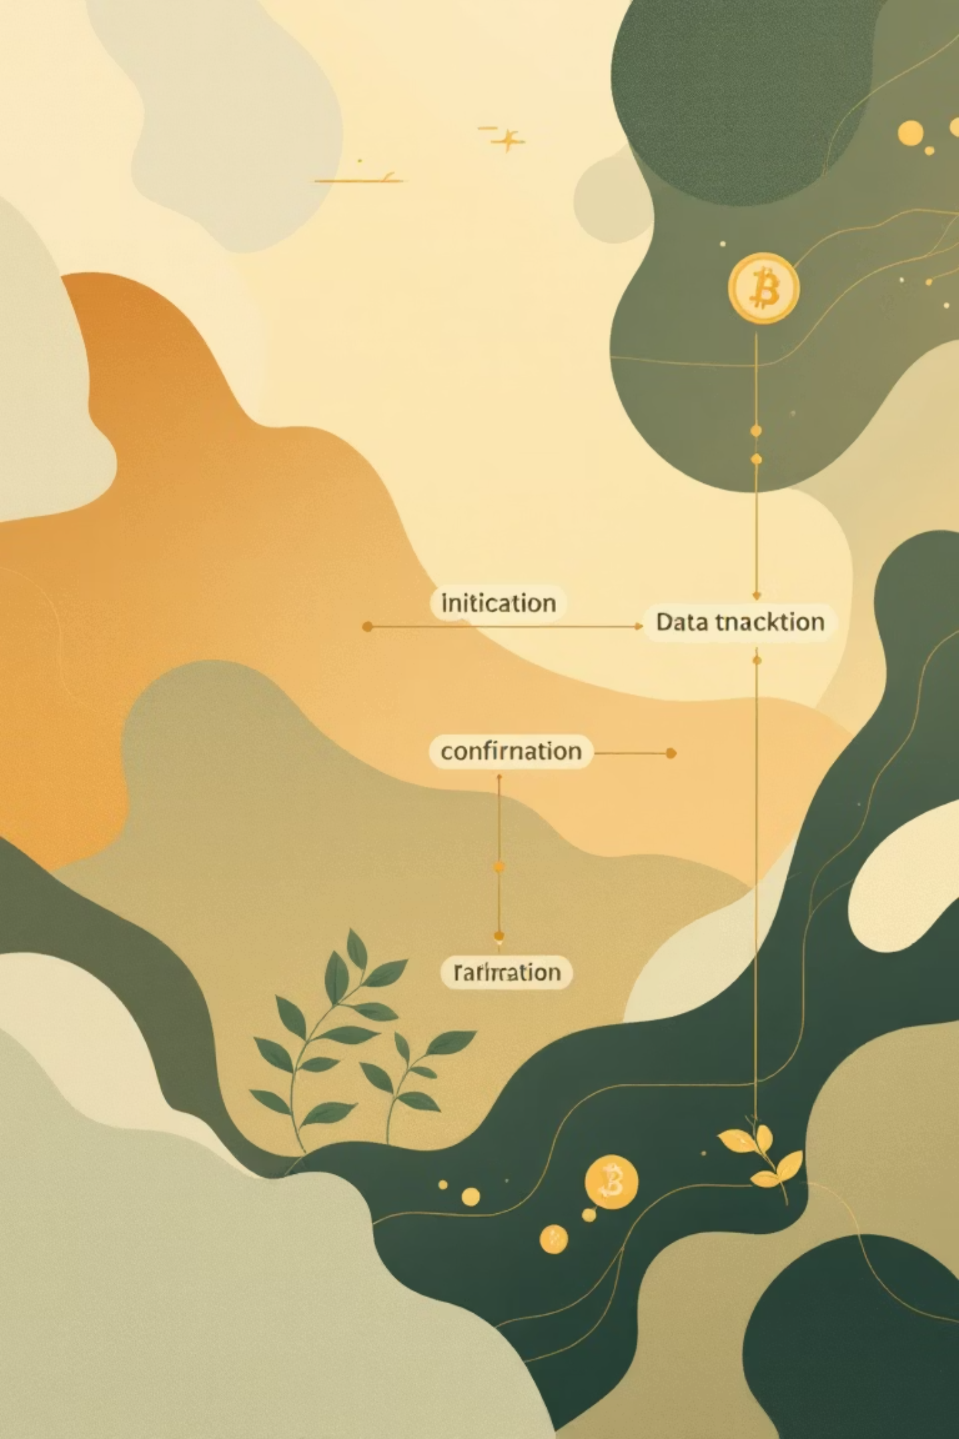




How BlockFund Works
Campaign Creation
Creators define project goals, milestones, and funding targets on the platform
Transparent Backing
Backers contribute funds, with each transaction recorded on the blockchain
Smart Contract Execution
Automated validation of milestones triggers fund release or refund mechanisms
Verifiable Outcomes
All stakeholders access immutable records of fund allocation and project progress

Slide 6
Real-World Applications
Startup Fundraising
Non-Profit Donations
Community Initiatives
Global Crowdfunding
Emerging technology companies secure seed funding with complete transparency, building investor confidence through verifiable milestone achievements and automated fund distribution.
Charitable organisations demonstrate accountability with real-time fund tracking, ensuring donors see exactly how their contributions create impact in communities worldwide.
Local projects from neighbourhood improvements to social programmes gain credibility through transparent fund management and community-verifiable progress reporting.
Cross-border campaigns eliminate currency conversion concerns and international transfer fees whilst maintaining security and transparency across jurisdictions.

Slide 7





Technology Stack
Backend Development
Python with Flask Framework
Lightweight, scalable web application framework handling routing, API endpoints, and business logic for blockchain operations.
Frontend Interface
HTML, CSS & JavaScript
Responsive, modern web interface providing intuitive user experience for campaign creation, donation management, and blockchain visualisation.
Data Management
SQLite3 Database
Efficient relational database managing user accounts, campaign metadata, and application state alongside blockchain records.
Blockchain Security
SHA-256 & Proof-of-Work
Cryptographic hashing ensures data integrity whilst consensus mechanisms validate each block, with dedicated endpoints for chain validation and verification.

Slide 8

Security Architecture
SHA-256 Cryptographic Hashing
Proof-of-Work Consensus
Computational validation requires solving complex mathematical puzzles before adding blocks. This mechanism prevents malicious actors from overwhelming the network and ensures distributed agreement on transaction validity.
Each block contains a unique hash generated from transaction data, timestamp, and the previous block's hash. Any attempt to alter historical data invalidates the entire chain, making fraud mathematically infeasible.
Chain Validation Endpoints
Real-time verification APIs allow any stakeholder to independently validate blockchain integrity. Automated checks ensure continuous monitoring of chain consistency and immediate detection of anomalies.

Slide 9






Key Benefits of BlockFund
100%
0%
85%
Transparency
Fraud Risk
Cost Reduction
Complete visibility of all transactions and fund movements
Immutable blockchain eliminates fraudulent campaign possibilities
Eliminated intermediary fees compared to traditional platforms
Automated Efficiency
Decentralised Trust
Verifiable Accountability
Smart contracts eliminate manual fund management, reducing processing time from days to seconds whilst ensuring milestone-based accountability.
No single point of failure or control. The distributed network ensures platform availability and removes dependency on centralised authorities.
Every stakeholder independently verifies transactions and project progress, creating unprecedented accountability between creators and backers.

Slide 10


Conclusion
BlockFund represents a paradigm shift in crowdfunding, leveraging blockchain technology to create a truly decentralised, transparent, and secure ecosystem. By eliminating intermediaries and automating fund management through smart contracts, we empower creators and backers to connect directly with complete confidence.
"Transforming crowdfunding through cryptographic security, automated transparency, and verifiable accountability—BlockFund builds the foundation for trust in the decentralised economy."

Slide 11
Thank You

